Slide 1

Design of Function Generator
Genesis Shadow Project
Status Report by:
Geethanjali B (99002570)
Shekar J K (99002593)
Hemalatha R (99002622)
Gajula Meghana (99002630)

Slide 2
Introduction

Slide 3
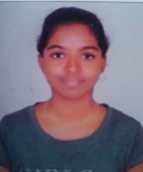


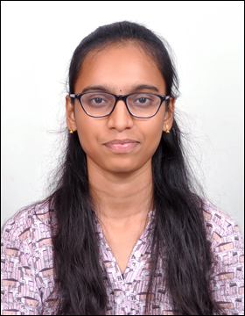
Project Highlights
Project Mentors
BU Mentor: Samyuktha B S and Sunney Kumar
GEA Mentor: Bharath G
BEH: Basil Casmir Joseph
Team
Intern Name: Geethanjali B
PS#: 99002570
GENESIS Track Code: 2009BLRMED01
Education Details: B.E(ECE)
Intern Name: Shekar J K
PS#: 99002593
GENESIS Track Code: 2009BLRMED01
Education Details: B.E(ECE)
Intern Name: Hemalatha B
PS#: 99002622
GENESIS Track Code: 2009BLRMED01
Education Details: B.E(CSE)
Intern Name: Gajula Meghana
PS#: 99002630
GENESIS Track Code: 2009BLRMED01
Education Details: B.E(CSE)

Slide 4
Problem Statement
Design a function generator to output various signals such as Sine, Triangular waveform, Pulse, Square, etc. It should also support custom functions

Slide 5
Function Generator
A function generator is an electronic test equipment used to generate different types of electrical waveforms over a range of frequencies.
The waveforms produced by the function generator are the sine wave, square wave, triangular wave and saw tooth shapes.
A common use is to test the response of circuits to a known input signal.

Slide 6
Scope
The scope of the project is to
Simulate the various hardware requirements of the function generator circuit
To analyze the signal by implementing the mathematical model of the signal's algorithm
To display the required waveform.​

Slide 7
Objectives
Requirements specification and detailed scope.
Understanding of Analog Front End
Safety, EMI-EMC
Understanding of mathematical models behind signals

Slide 8
Key Deliverables
Requirements specifications
Detailed design calculations and schematics
Component Selection
Firmware Design, Flow Chart, State Diagram, Pseudo Code or Python Code

Slide 9
Implementation

Slide 10
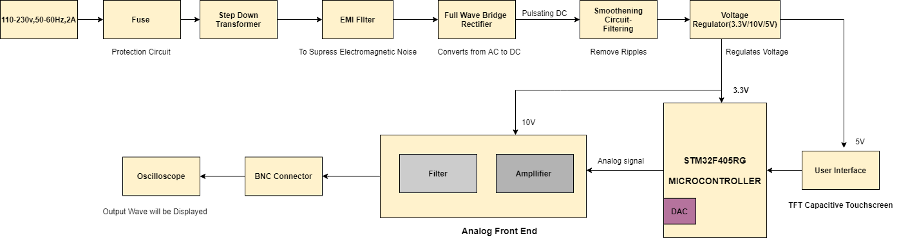
Block Diagram
The Input from the power supply that is the regulated 3.3V DC is required to power up the controller.
The Microcontroller powers up, the user interface (Capacitive touch Screen Display) is interfaced with this through the Communication Protocols or the Specified Pins.
Then the Analog Front End has Amplifiers and filters to get the required amplitude of the output waveform that will be Noise Free.
The Output will be displayed in Oscilloscope using BNC- BNC Connectors.

Slide 11
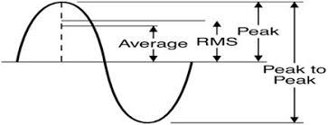
Power Supply Section
The supply 110-230V,50-60Hz is designed based on the requirement.
The Input is provided to Step down Transformer is 230V, 50 Hz (India) after stepping down the output voltage is 12V AC (Vpeak= 17V)
Now AC signal must be converted to DC so here Bridge Rectifier is used.
This signal is passed through filter to smoothen the wave and to remove ripples.
Voltage regulator is used to Regulate as per the required Voltage to power up the components.

Slide 12
Requirement Specification - Requirement_Specifications
Hardware Design Document- Hardware Design Documentation.docx
Bill of Materials – BOM
Pin Mapping - Microcontroller pin diagram
Schematics - Schematic

Slide 13
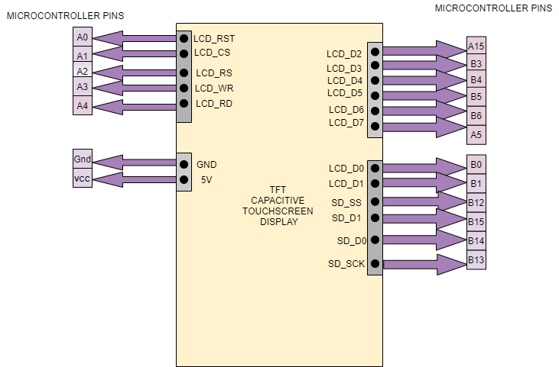
Interfacing with the Display
TFT Capacitive Display Interface
TFT has 5 Control pins they are LCD_RST, LCD_CS, LCD_RS, LCD_WR, LCD_RD
Remaining would be GPIO pins that is used as Data pins they are:
LCD_D0, LCD_D1, LCD_D3, LCD_D4, LCD_D5, LCD_D6, LCD_D7, LCD_D2.

Slide 14
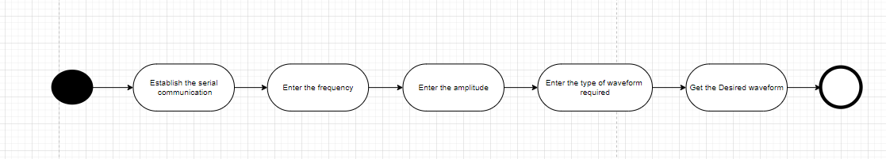
SOFTWARE WORKFLOW
The user has to establish the serial communication by selecting which port is required and the required Baudrate for that port.
After the communication is established the GUI is designed

Slide 15
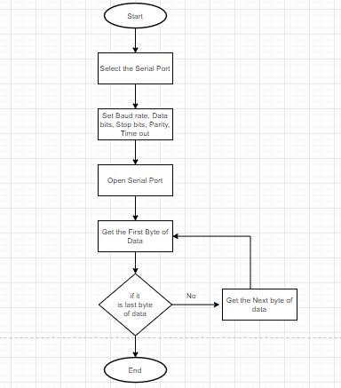
SERIAL COMMUNICATION
The flowchart is of the UART Communication Protocol, to setup serial communication we need to do the following steps:
Setup the Serial Port
Set Baud rate, Data bits, Stop bits, Parity and Timeout
Open serial port
Read the data till last byte

Slide 16
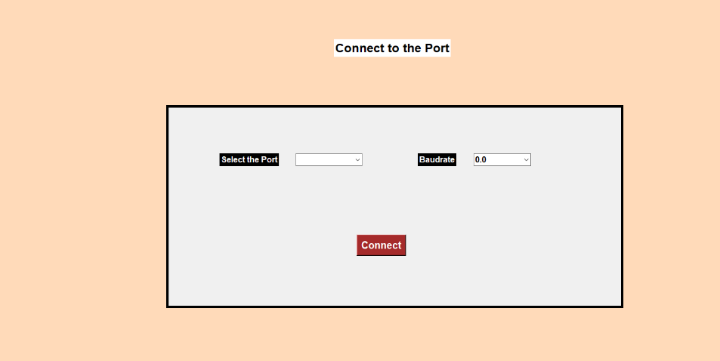
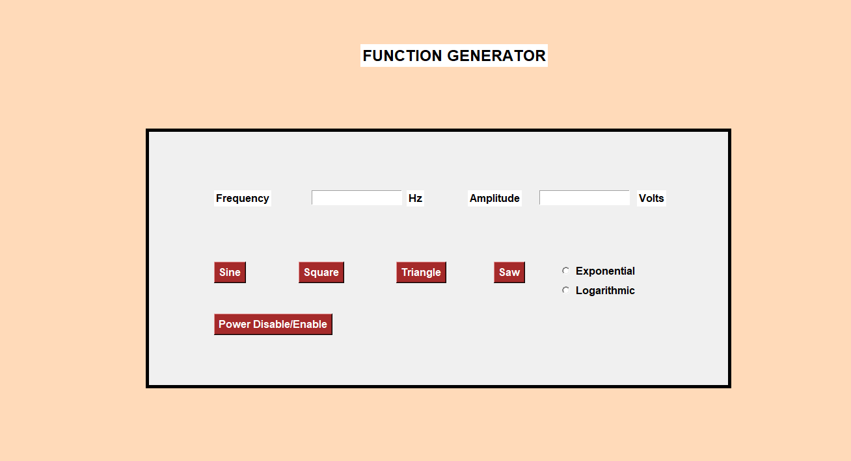
GUI Design
This is the GUI designed based on the requirement specifications.
The GUI designed in Python language whereby importing the TKinter Module.
The GUI has different buttons.
Once the selections are done, the user must submit the values.

Slide 17
DESIGN DOCUMENT
Software Design Documentation - Software Design Documentation
UART Commands - Uart_Commands

Slide 18
Weekly Progress

Slide 19
Project Timeline
Completed
Active
Yet to Start
S.No | Tasks | Week 1 | Week 2 | Week 3 | Week 4 | Week 5
1. | Understanding the System
2. | Requirement Specifications
3. | Block Diagram/Methodology
4. | Understanding of the tool used
5. | Simulation of the system
6. | Designing the firmware/algorithm
7. | Testing of the algorithm/firmware
8. | Validating the results on simulator
9. | Submission of project

Slide 20
Task Summary
Completed
Active
Yet to Start
Tasks during Week 1 and Week 2 (18-11-2020 to 28-11-2020)
Sl No | Tasks | Activity | Remarks
1 | Understanding the System | Exploring resources
 |  | Problem statement, Objectives
2 | Study on Concepts | Understanding the power supply section
 |  | Analog Front End | New concepts
 |  | Digital to Analog Converter
 |  | Safety measurements
3 | Block Diagram | Designing power supply section | Selection between SMPS or LMPS
4 | Documentation | Requirement Specifications and Weekly report | Achieved major deliverable

Slide 21
Completed
Active
Yet to Start
Tasks during Week 3 and Week 4(30-11-2020 TO 12-12-2020)
Sl No | Tasks | Activity | Remarks
1 | Study of Selection of Components | Comparing different types of Microcontrollers
 |  | Various other components like DAC, Temperature sensor and display
2 | Study on Concepts | Understanding Mathematical equations of the signals
 |  | Analog Front End
 |  | Interfacing the peripherals to the microcontroller
 |  | GUI for function generator
3 | Block Diagram | Designing main block diagram
 |  | Designing of Power supply section

Slide 22
Completed
Active
Yet to Start
Tasks during Week 3 and Week 4(30-11-2020 TO 12-12-2020)
Sl No | Tasks | Activity | Remarks
4 | Simulating the system | Installation of IDE
 |  | Simulating in the Online tool
5 | Designing the firmware | Implementing the GUI
 |  | Implementing the logic
6 | Component Selection | Selected components based on previous study.
7 | Documentation | Hardware Design Document
 |  | Software Design Document

Slide 23
Completed
Active
Yet to Start
Tasks during Week 5 (14-12-2020 TO 22-12-2020)
Sl No | Tasks | Activity | Remarks
1 | Documentation | Daily and Weekly reports
 |  | Hardware Design Document
 |  | Software Design Document
 |  | Final PPT for the Review
2 | Simulating the system | Installation of IDE
 |  | Simulating of Power Supply in LTSpice
3 | Designing of Firmware | Improving the GUI
 |  | Implementing the Logic
4 | Schematic Design | Designed in LTSpice

Slide 24
Thank you

